Slide 1
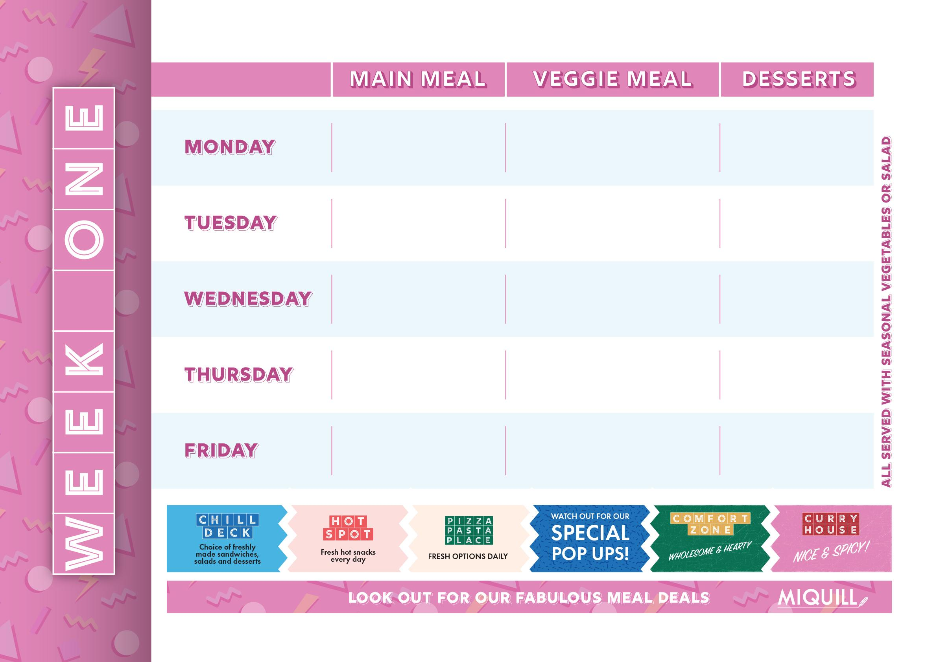
Jerk Chicken Thigh Burger Iced Chilli Broccoli, Diced Potatoes | Falafel Burger Diced Potatoes, Lemon Mayonnaise, Iced Chilli Broccoli | Warm Apple Flapjack
Pulled BBQ Pork Seasoned Wedges, Charred Onions | Non Chicken Strip Folded Naan Sweetcorn Salsa | Bread & Butter Pudding, Custard
Roast Chicken with Stuffing, Roasties, Roots & Gravy | Roast Vegetable Megamix With a Cheese Scone | Manchester Tart Pot
Beef Keema Braised Cumin Rice, Curry Spiced Courgettes | Vegetable Samosa Braised Cumin Rice, Curry Spiced Courgettes | Gingerbread Swirl, Citrus Glaze
Chip Shop Grab & Go: Battered Fish, or Cheese & Tomato Pizza. Gravy, Mushy Peas or Curry Sauce also available | Chip Shop Grab & Go: Veggie Sausage, Pizza with Chips Gravy, Mushy Peas or Curry Sauce | Jaffa Orange & Chocolate Pot
Week Commencing:

Slide 2
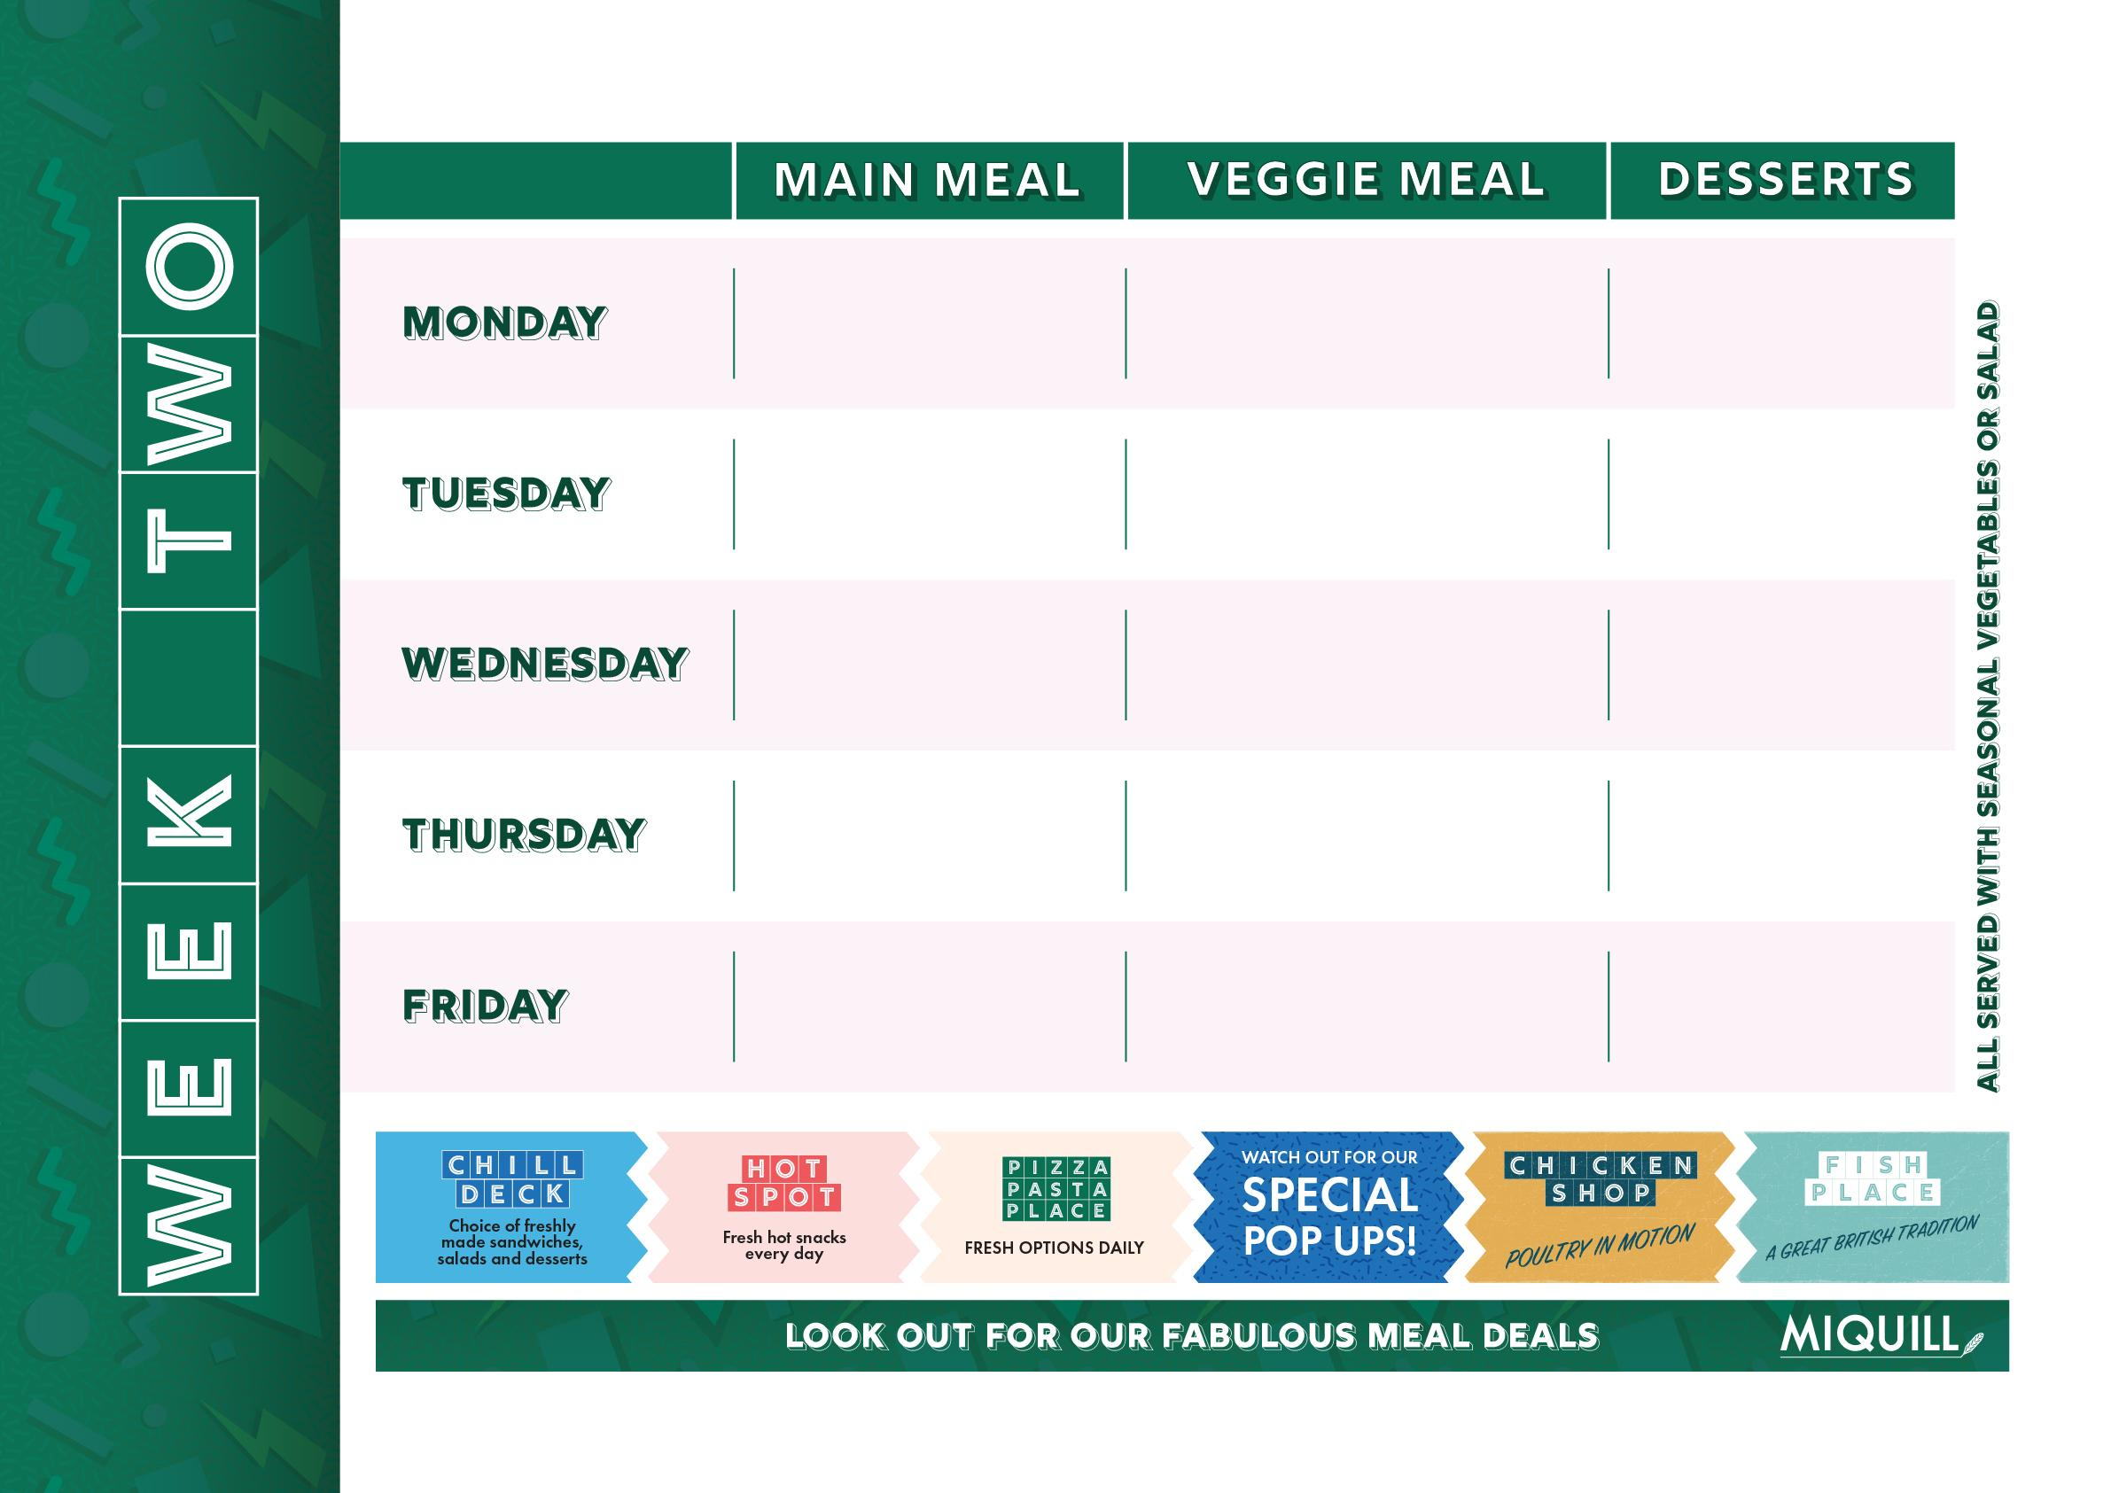
Mega Dog Seasoned Wedges, Crispy Onions, Mustard & Tomato Ketchup | Mega Veggie Dog Seasoned Wedges, Crispy Onions, Mustard & Tomato Ketchup | Maryland Cookie
NYC Burger Joint Smashed Patty,Crispy Potatoes, Cheese & Gherkins , | Vegan Chilli Con Carne Nacho Chips & Salsa | Banoffee Pie Pot
Glazed Roast Gammon, with, Roasties, Roots & Gravy | Caramelised Leek Macaroni Cheese B.B.Q Drizzle | Old School Sprinkle Sponge & Custard
Hot Chicken Caesar Salad Wrap | Broccoli & Cauliflower Popcorn Bean Salsa,Noodles, Soya Pak Choi | Chocolate Brownie
Chip Shop Grab & Go: Battered Fish, or Cheese & Tomato Pizza. Gravy, Mushy Peas or Curry Sauce also available | Selection of: Veggie Burger, Veggie Fingers & Chips with Curry Sauce or Gravy, Mushy Peas or Baked Beans | White Chocolate & Raspberry Blondie
Week Commencing:

Slide 3
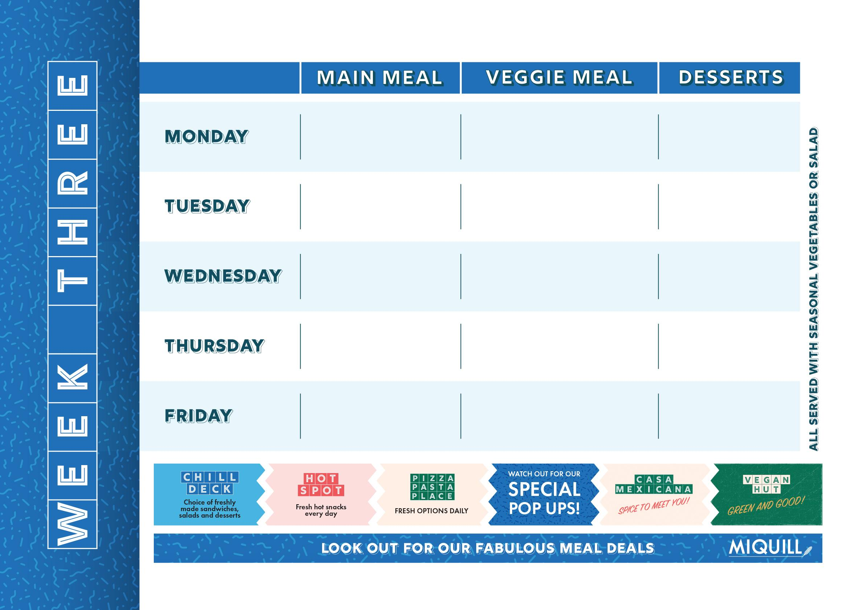
Chicken Kiev Quesadilla | Spring Vegetable Enchilada | Oat & Cinnamon Cookie
Pork Kofta Pitta Bread, Salad & Mango Chutney | The Big bhaji Burger Minted yogurt Iceberg lettuce Grilled Bun | Chocolate Crispy Bar
Mexican Roadside Chicken With Potatoes, Rice & Tortilla Chips | Roasted Cauliflower Steak Roasties & Spring Greens | Sticky Toffee Pudding
Poppadom Pile On Nation's Favourite Chicken Tikka Masala with Rice, Mint Yoghurt | Sweet Potato, Spinach & Chickpea Curry with Rice, Mint Yoghurt | Lemon Cheesecake
Chip Shop Grab & Go: Battered Fish, or Cheese & Tomato Pizza. Gravy, Mushy Peas or Curry Sauce also available | Chip Shop Grab & Go: Veggie Sausage, Pizza with Chips Gravy, Mushy Peas or Curry Sauce | Fruit Split
Week Commencing:

