Slide 1


March Catering Newsletter
We are delighted to introduce your new catering newsletter, which will be shared with all students at the start of every month.
Each month we will focus on previous menu highlights, alongside exciting new dishes and initiatives that are planned for the future.
We hope that by sharing upcoming events and menus, alongside your feedback, together we can help all students to have a voice in your catering provision
So lets get started!

Slide 2


News from inside the kitchen.
In March we met with a cross section of students to gain feedback on our morning break offer. An overview of some of the feedback and our plan to help improve your morning break catering experience is as follows:.
Brownies are now on our new morning break menu. Can you spot the hidden vegetables!
These have been added to our new morning break menu.
Consider it done! Even better, all cinnamon rolls will be homemade!
Thankyou for your feedback, we have added these to our new morning break menu.
We would like chocolate Brownies.
A breakfast pot would be amazing!
We used to have cinnamon rolls at breaktime.
Could we have toasties on offer?

Slide 3
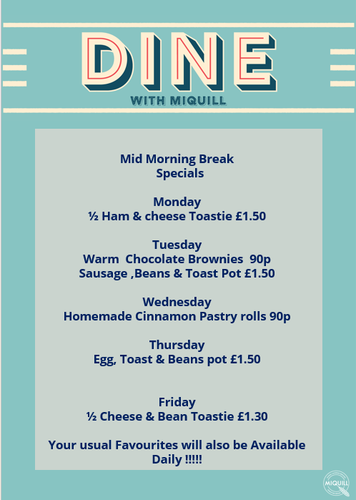
Changes to the Morning Break Menu.
Following student feedback, the below daily additions will be on offer every week, alongside your usual favourites
Start date: 31st March 2025.

Slide 4
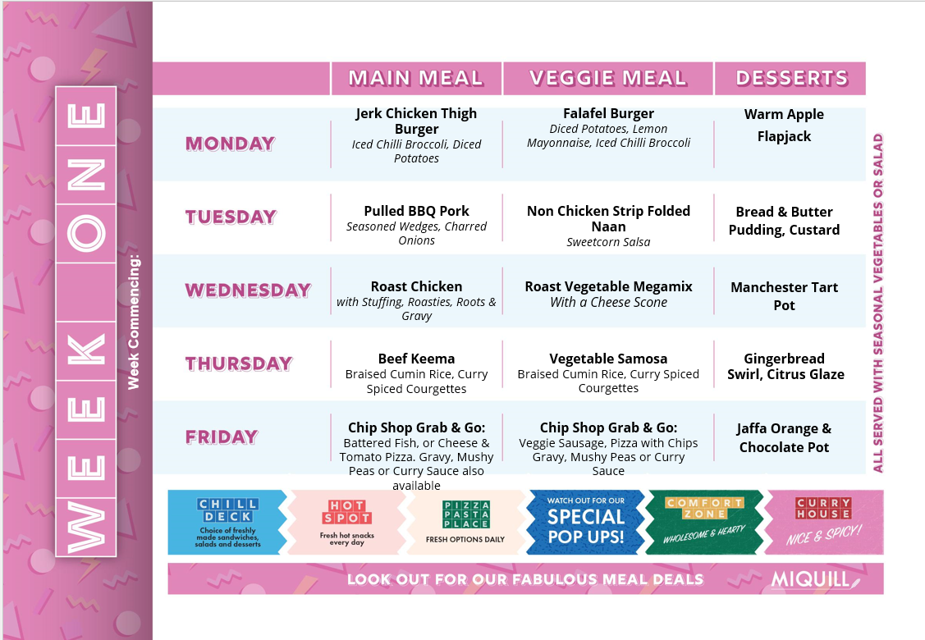
Our New Spring Lunchtime Menu.
In addition to the new morning break offer, we are delighted to announce that our new spring menu will launch after the Easter holidays!
Details of the full three weekly menu cycle are contained within the following pages.

Slide 5
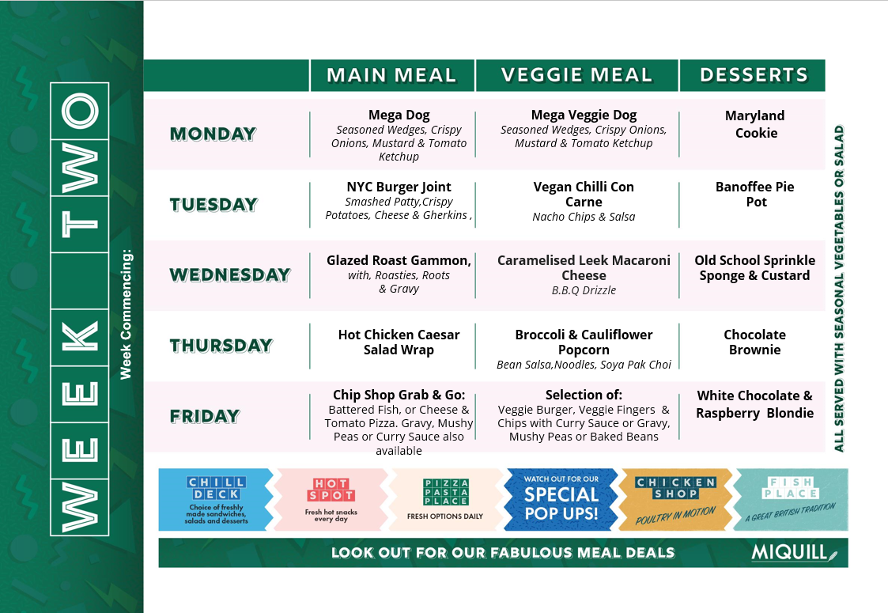

Slide 6
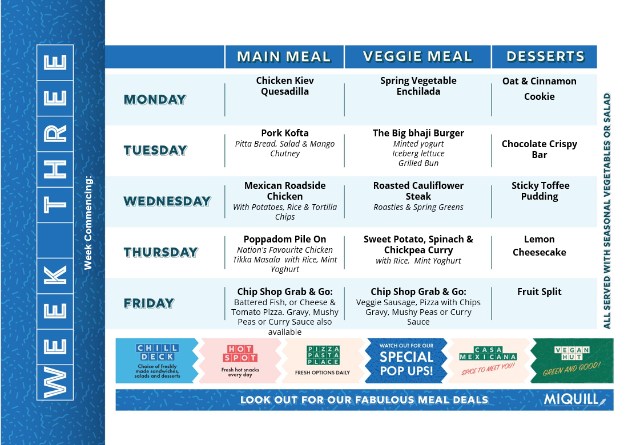

Slide 7
What's next?
Over the coming weeks we plan to review our sixth form food offer and would appreciate your feedback!
If you are a current sixth form student and would like to help us with our planning, please do let you form tutor know and we will be in touch with further details.
Thankyou for taking the time to read our first newsletter. We hope that this will give you exciting insights into the menu development and initiatives that are coming soon!

